Slide 1
Büyük Veri
Apache Kafka

Slide 2

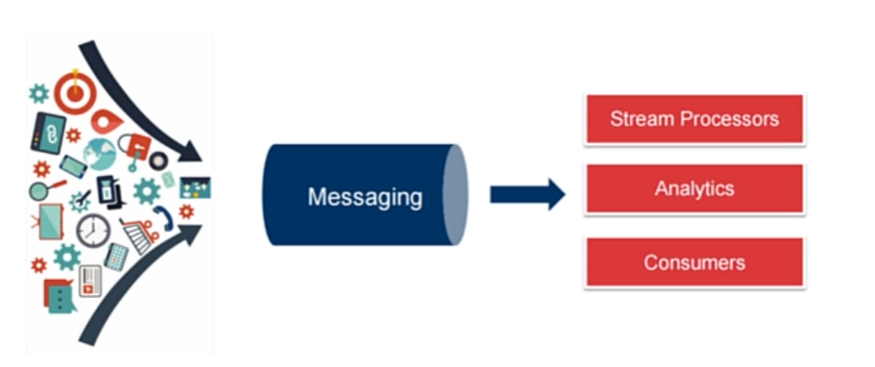
Apache Kafka

Slide 3
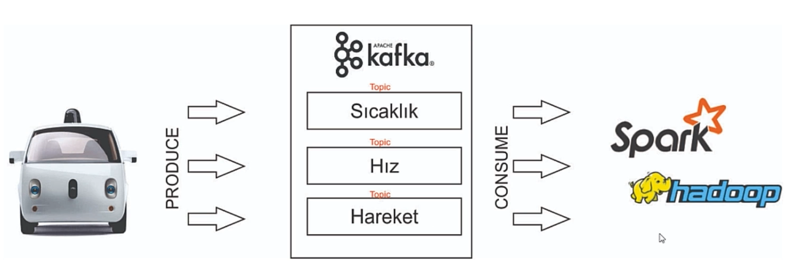
Apache Kafka

Slide 4
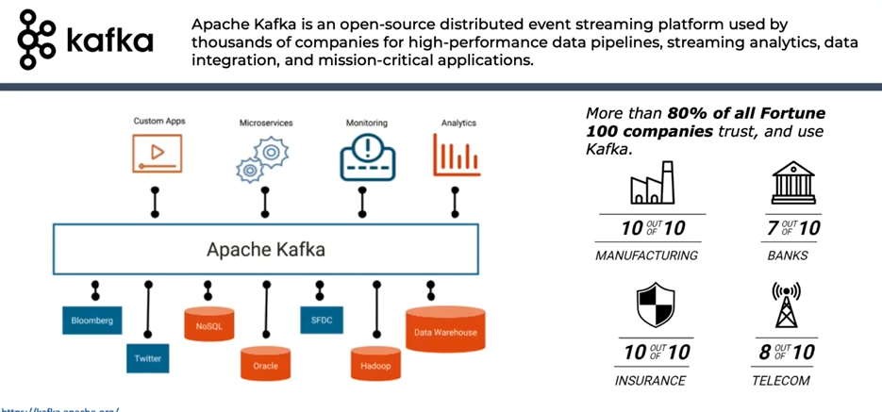
Apache Kafka

Slide 5
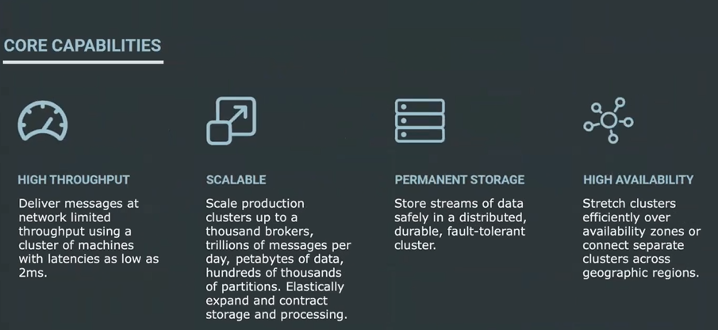
Apache Kafka

Slide 6
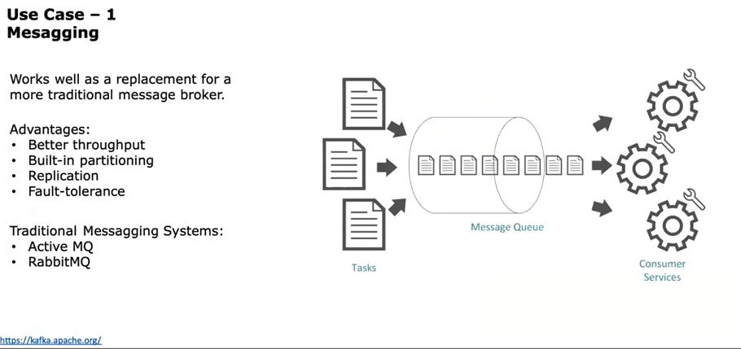
Apache Kafka

Slide 7
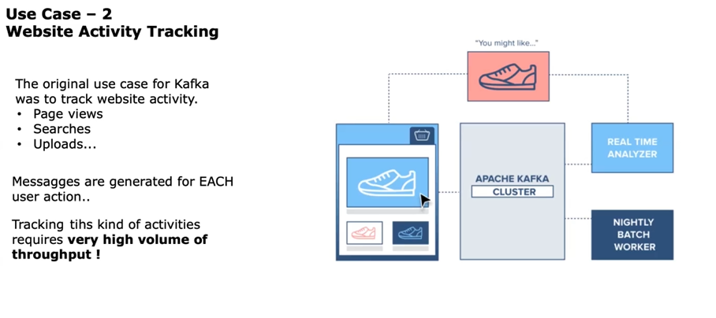
Apache Kafka

Slide 8
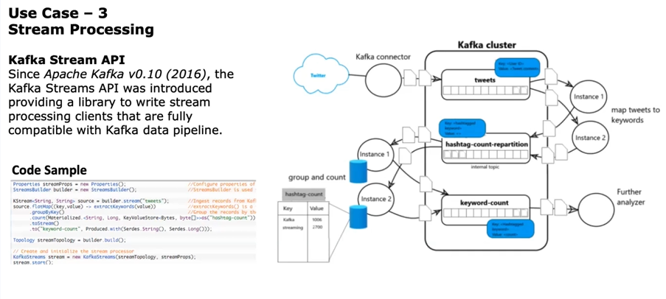
Apache Kafka

Slide 9
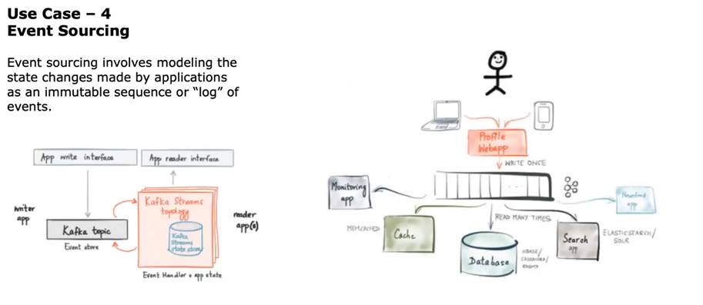
Apache Kafka

Slide 10
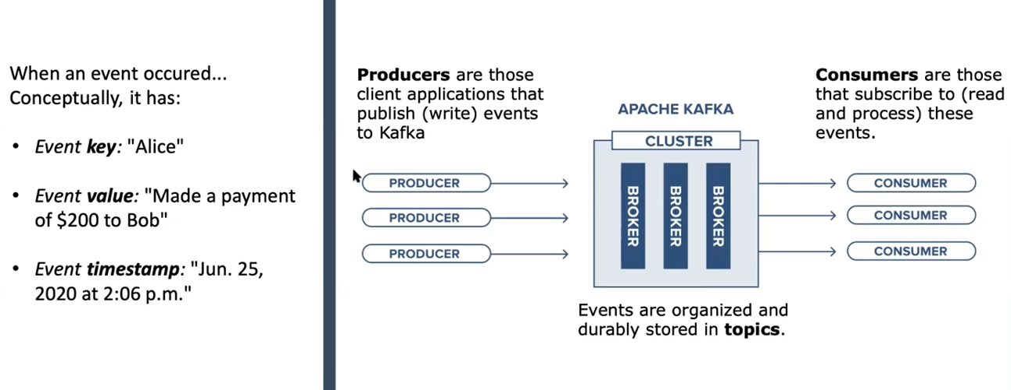
Technical Details

Slide 11
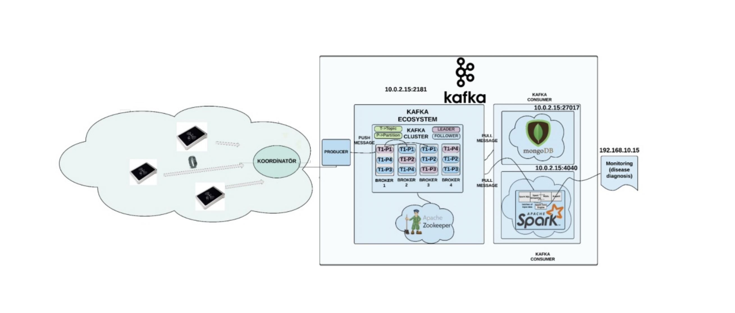

Slide 12
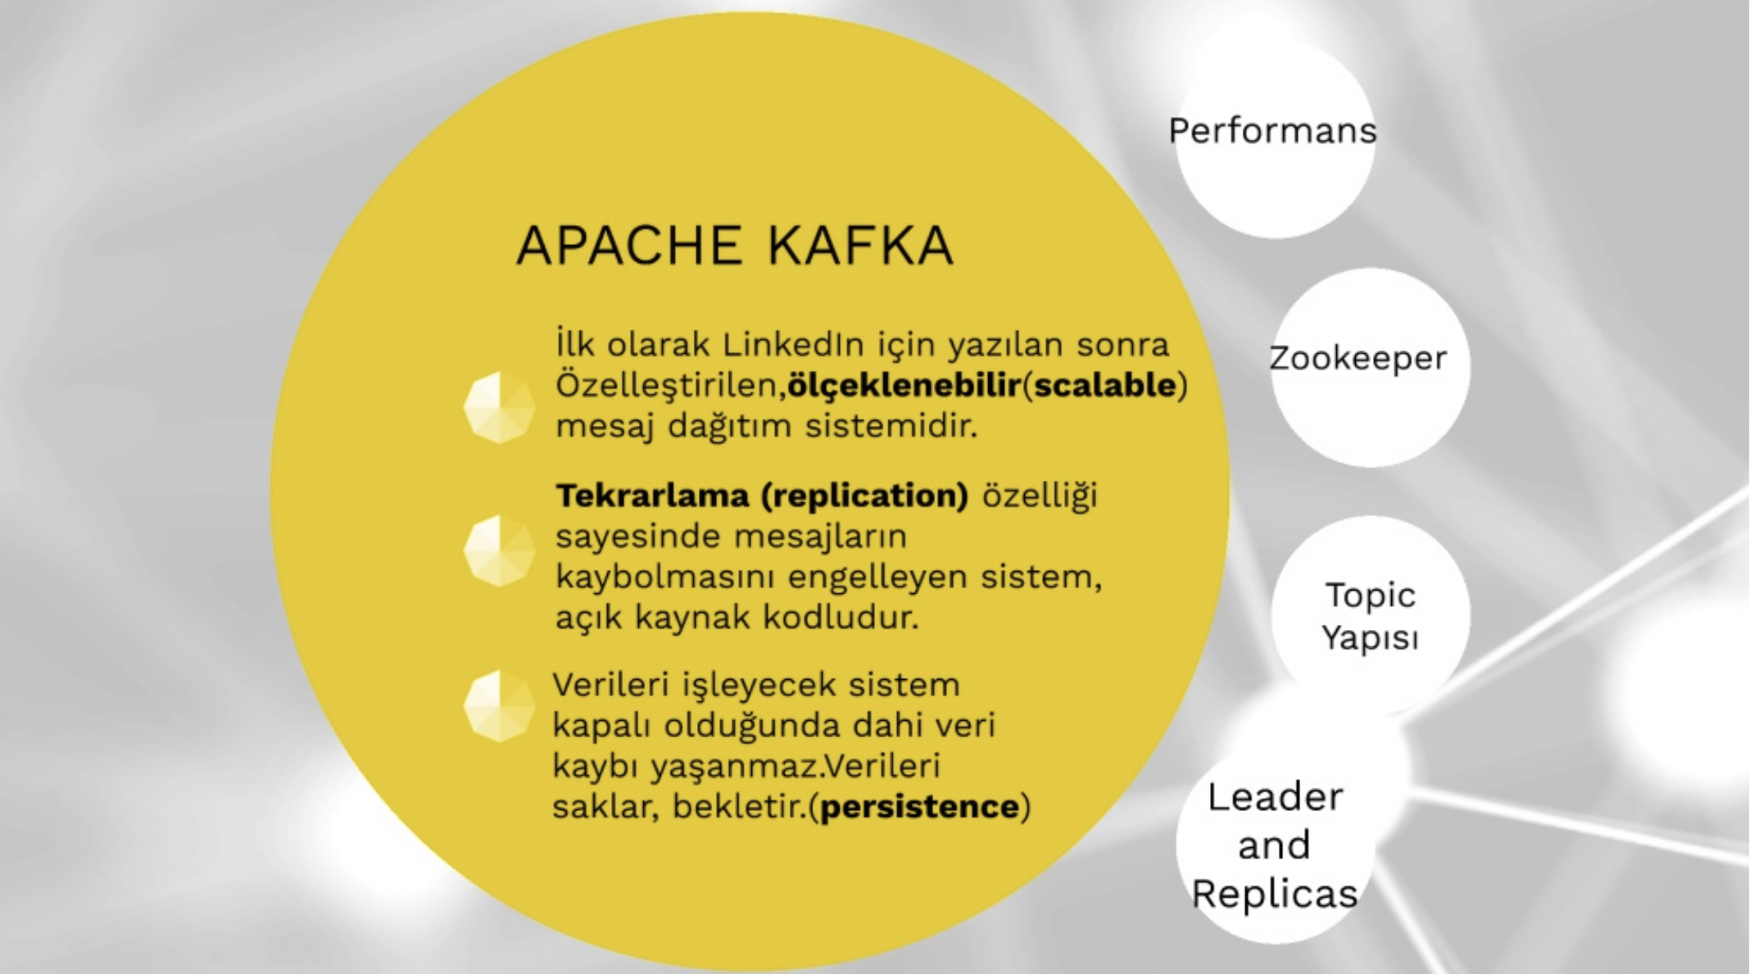

Slide 13
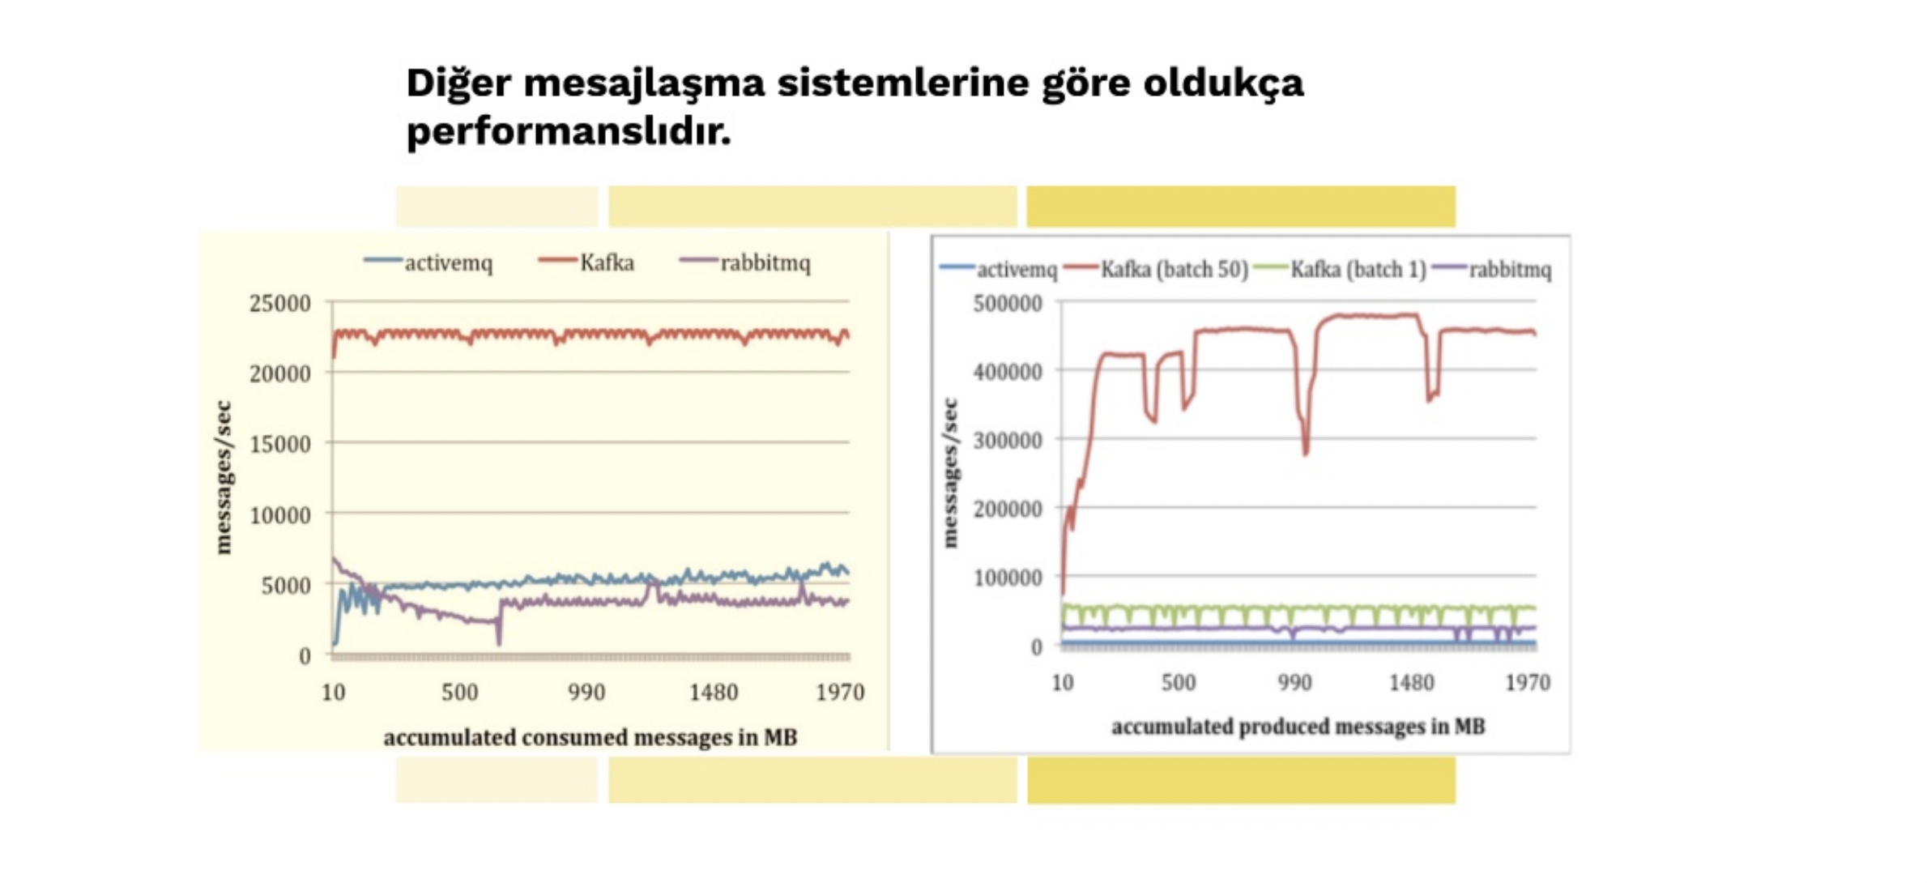

Slide 14
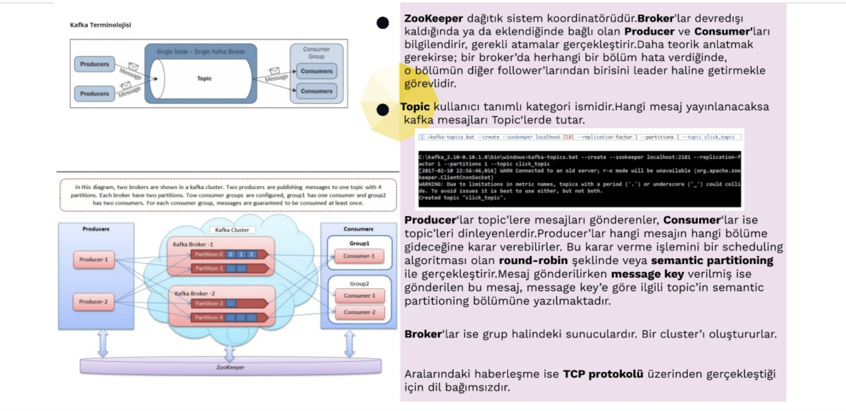

Slide 15
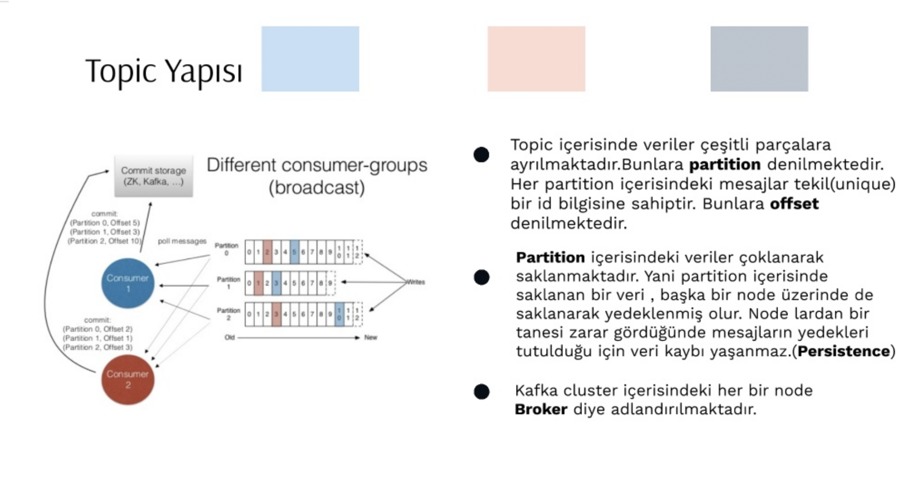

Slide 16
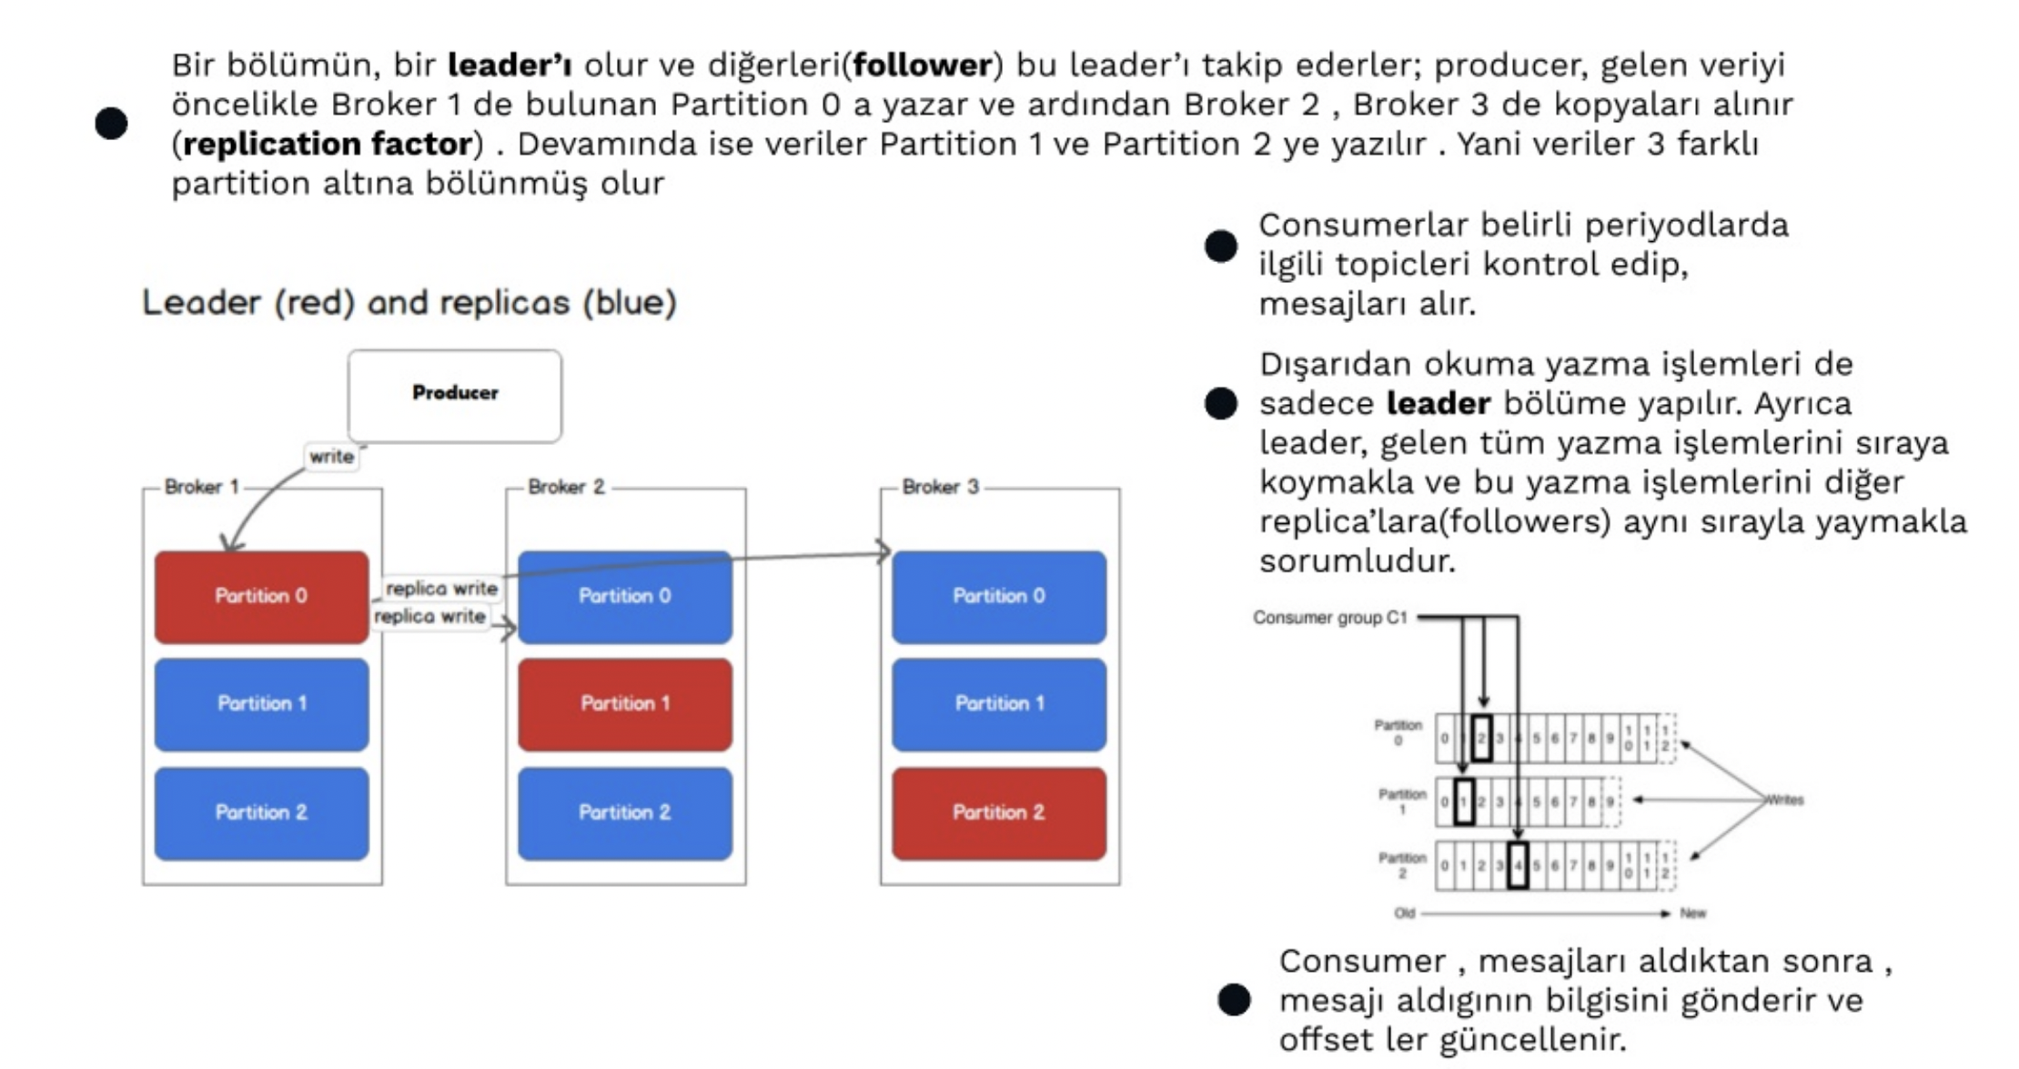

Slide 17

Apache Zookeeper
Apache Zookeeper coordinates resources management
in distributed server architecture.
Generally, it is used for coordination and it held
configuration files.

Slide 18
Apache Kafka
Apache Kafka Windows Installation
To install Apache Kafka on our computer, we will first go to the Apache Kafka Download page.
From here we will download the appropriate version. (kafka_2.11-1.1.0.tgz is my preference)
We will unzip the downloaded file and copy it to the C: directory.
We will update the server.properties file in the config folder;
We will add the log.dirs=C:\kafka_2.10-0.10.1.0\kafka-logs section.
The installation process is complete.

Slide 19
Apache Zookeeper
To run Apache Kafka Server, you must first run Zookeeper.
For this process, we open the Windows Command Store (cmd).
Type zkserver command and press enter
This window remains open. Then we open a new Windows Command Line
We come to the directory where Kafka is located.
We write C:\kafka_2.10-0.10.1.0\bin\windows> kafka-server-start.bat ..\..\config\server.properties

Slide 20
A. Kafka Producer, Consumer and Topics
Create Topic
List Topics
topic name

Slide 21

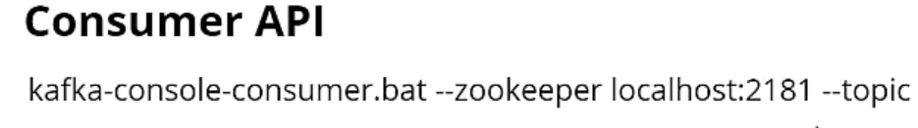
A. Kafka Producer, Consumer and Topics
topic name
topic name

Slide 22
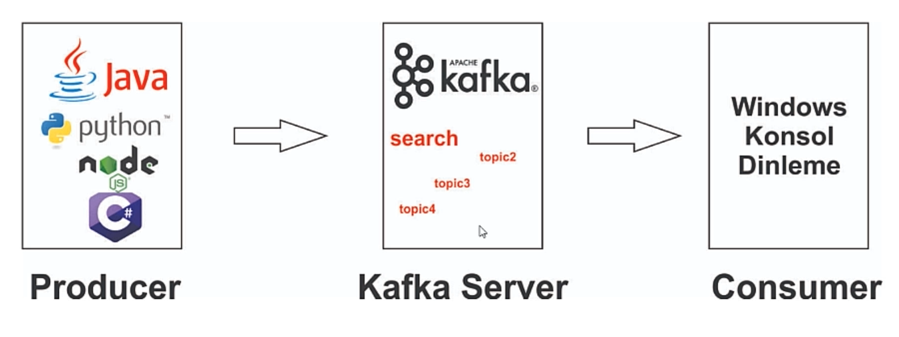
Kafka and Java Integration- Writing Producer Example

Slide 23
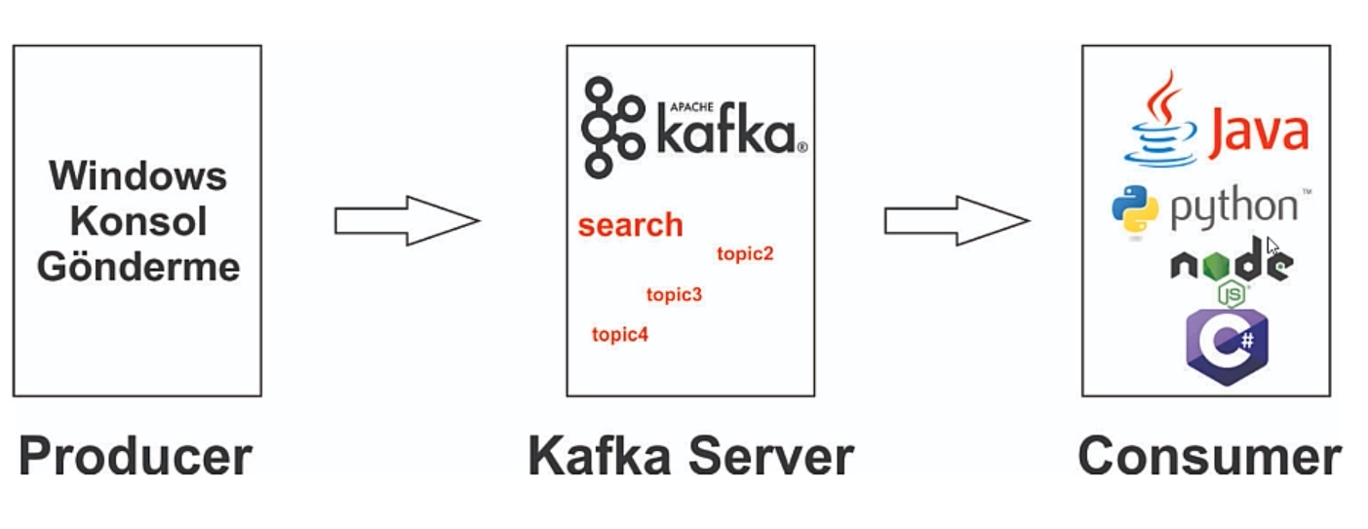
Kafka and Java Integration- Writing Consumer Example

